Slide 1


God BLESS FxA
Sai Prashanth Chandramouli
Firefox Accounts
irc: saipc
Github: TDA
E-mail: thatsenough@youstalker.com

Slide 2
Disclaimer
All details on these slides are purely fictitious based on fact.
No Animals were harmed in the making of this slideshow (unless you count me).
I make obscure references to filmography and some computer fields. Ask if it is unclear.
Any references, messages, images bearing resemblance to any real life object, person or animal were probably NOT coincidental, and any that are found to be offensive were probably meant to be offensive.
So quit whining and let’s move on to the next slide.
P.S: Most of this was copied over from last year, actually, all of it.

Slide 3
Why the crappy title?
Frankly speaking, cause I couldn’t come up with anything better.
But more importantly, cause my work this summer can be categorized into 5 things:
B – Bugs (Quite a few of them, you will see)
L – Linting (Again???)
E – E-Mails (funny cause I have been working with emails for 1.5 years now)
S – Styles (CSS & Less <3)
S – Security (Finally, something important eh?)

Slide 4
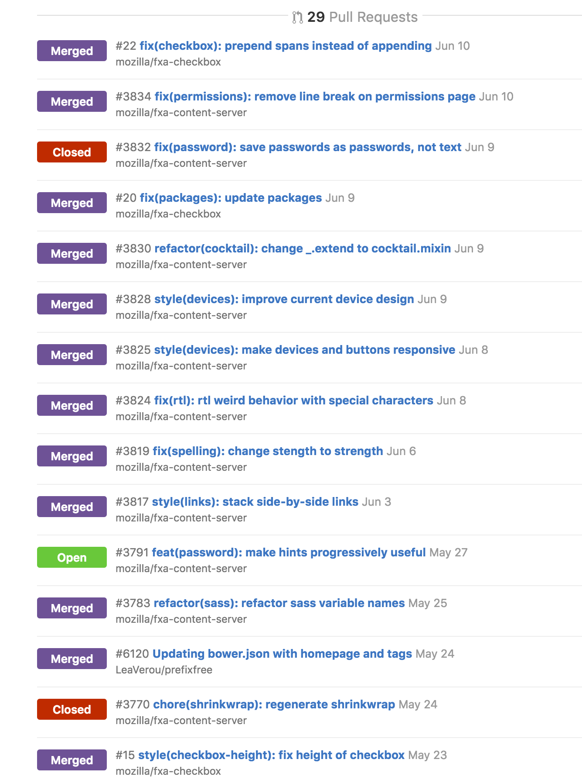
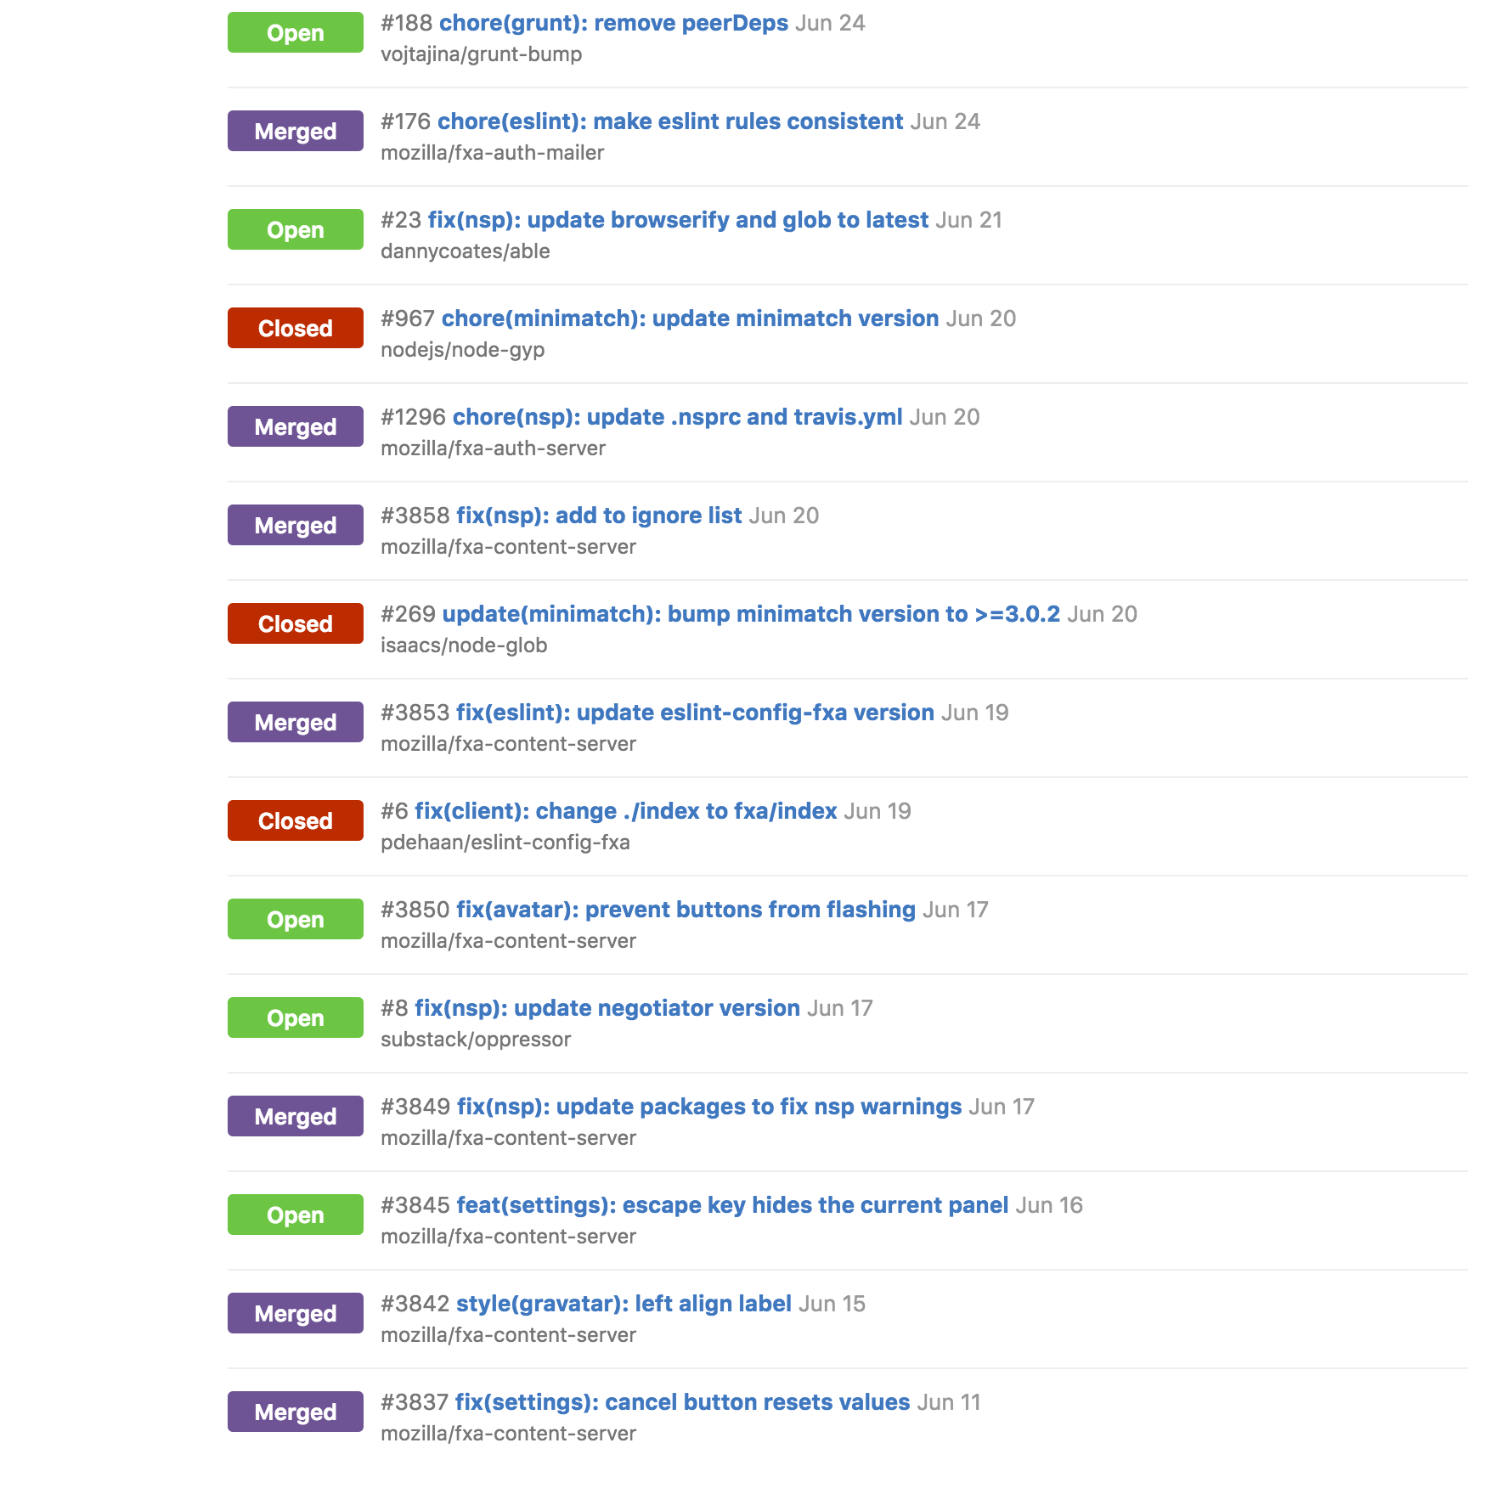
So how did my Summer go?
I worked on a bunch of bug fixes, 47 to be exact.

Slide 5
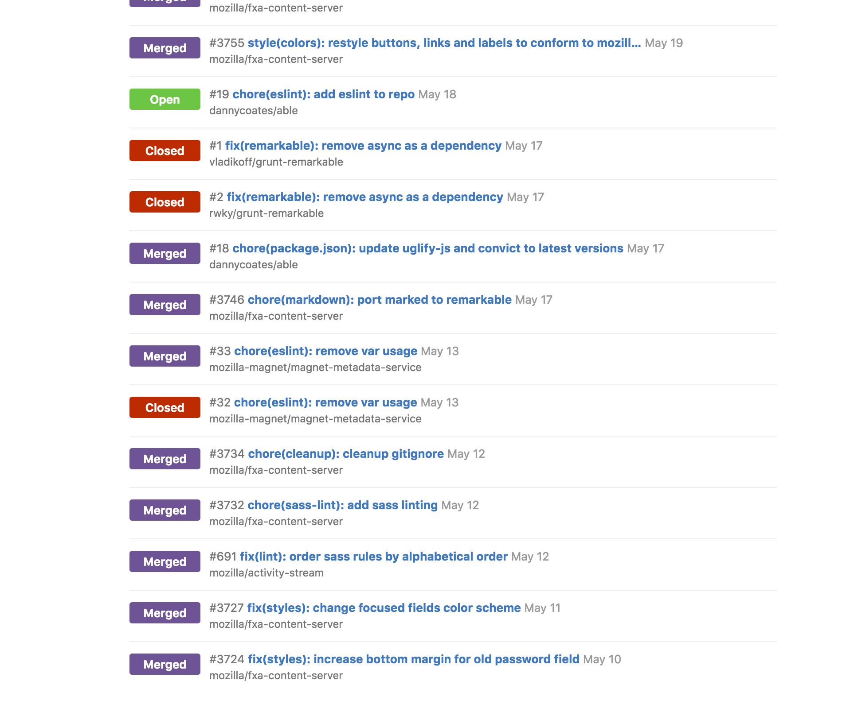
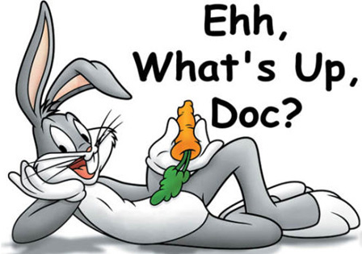
Just bugs?
Why you hating on bugs? Bugs’ important, listen to the guy on the right.

Slide 6
Well.. And?
Plenty of small bugs like:
ESLint fixes
Sasslint fixes
Node Security Advisories – Updating dependencies
Sometimes going 4-5 repos downstream
Style fixes, like
Widths, heights and the like
Stacking links
Making devices view responsive
Using ultra cool CSS stuff like `fit-content` and `calc`
Weird RTL issues
Aligning fxa-checkbox
Preventing buttons from flashing on page load (not FOUT)
Adjusting clickable areas in forms and links

Slide 7
Any features…?
Ok, and some small handy features:
Added sass-linting to our repos
Making FxA settings panels more keyboard accessible
Unified the styles used in FxA with those in Mozilla’s Style Guide for buttons, colors, links and text
I also refactored our files, ensuring that:
We used better variable names in our sass files
We used better variable values in our sass files
We ported to Cocktail from Underscore, completely

Slide 8
Did you actually do anything useful? Like a project?
Surprisingly, I actually did work on 3 really nice projects this Summer:
Password hints – Making better passwords a reality
Geolocation data in e-mail communication
Geoprofiling based on user history

Slide 9
Password Hints
Problem:
People choose crappy passwords
Stuff like “Password”, “abc123”, “dragondragon”
Attackers might bruteforce into an account by trying out common passwords
But isn’t bruteforcing rate-limited? How can attackers try ALL possible common passwords?

Slide 10
Password Hints – Continued..
Real problem:
People use the same crappy passwords across different websites
Leads to something called ”Password Reuse Attack”
Famous examples:
HBGary hack
Houston Astros
GitHub
Carbonite

Slide 11
Password Hints – Continued..
So what do we do?
You can make Software as secure as possible, doesn’t matter
Salting
Stronger Encryption
Weakest link in the chain
Humans
Treat the disease, not the symptoms

Slide 12
Password Hints – Continued..
So what did we do?
Bloomfilter based Password Strength Checker
Last summer, we detected weak passwords
This summer, we protected the users
Interactive password prompts to help users create a stronger password

Slide 14
Security vs Usability
So why not block the weak passwords altogether¹?
Usability is affected when you enforce strict rules on the users
Ultimately, users should be allowed to decide what they want
https://support.mozilla.org/en-US/kb/create-secure-passwords-keep-your-identity-safe
[1] http://gizmodo.com/microsoft-is-banning-your-dumb-passwords-1778848643

Slide 15
Geolocation Data in e-mails
Problem:
We get a lot of e-mails from different websites telling us about new log-ins
Users need enough data to know if they were the ones that really logged in, or an attacker was trying to log in to their account

Slide 16
Geolocation e-mails – Continued..
What do we do:
At the very minimum, we need:
IP Address used to login
Device that was used to login
City, Country of login
Time of login

Slide 17
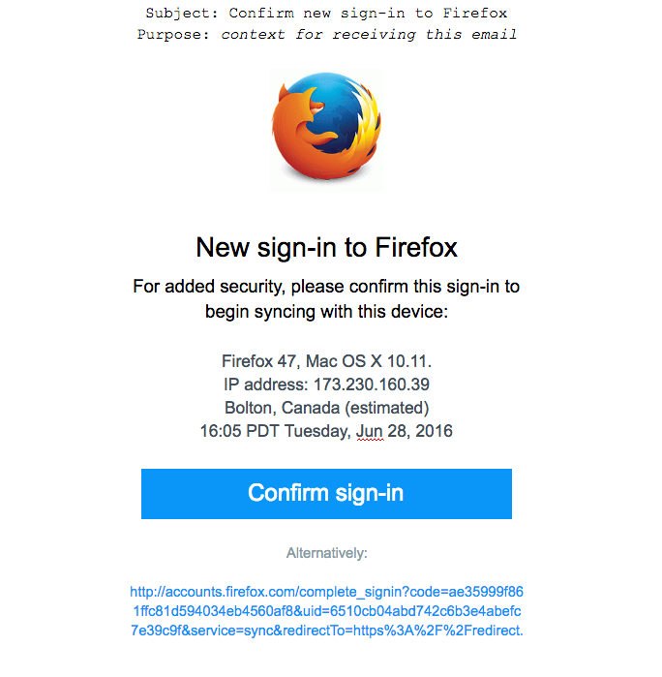

Slide 18
Mozilla fxa-geodb
We created a new node module, which can perform reverse IP lookup
Makes use of the maxmind IP databases
Allows automatic updates of the IP databases that we use
99.8% accurate on a country level
72% accurate on a city-level with a 62 mile (100km) radius.
Can be found at mozilla/fxa-geodb on github

Slide 19
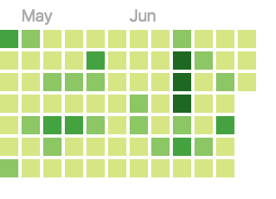
So how was my Summer you ask?
In one word: Awesome.
In three words: Productive and Awesome.

Slide 20
Thanks to..
The FxA Team:
John Morrison (jrgm) – For require(module)
Ryan Feeley (rfeeley) – For all the UX guidance, and the numerous revisions and reviews.
Daniel Coates (dcoates) – For merging my PR’s for `able`.
Phil Booth (pb) – For flexboxes
Sean `Monstar` – For the security stuff
Jon Buck – For being a gladiator

Slide 21
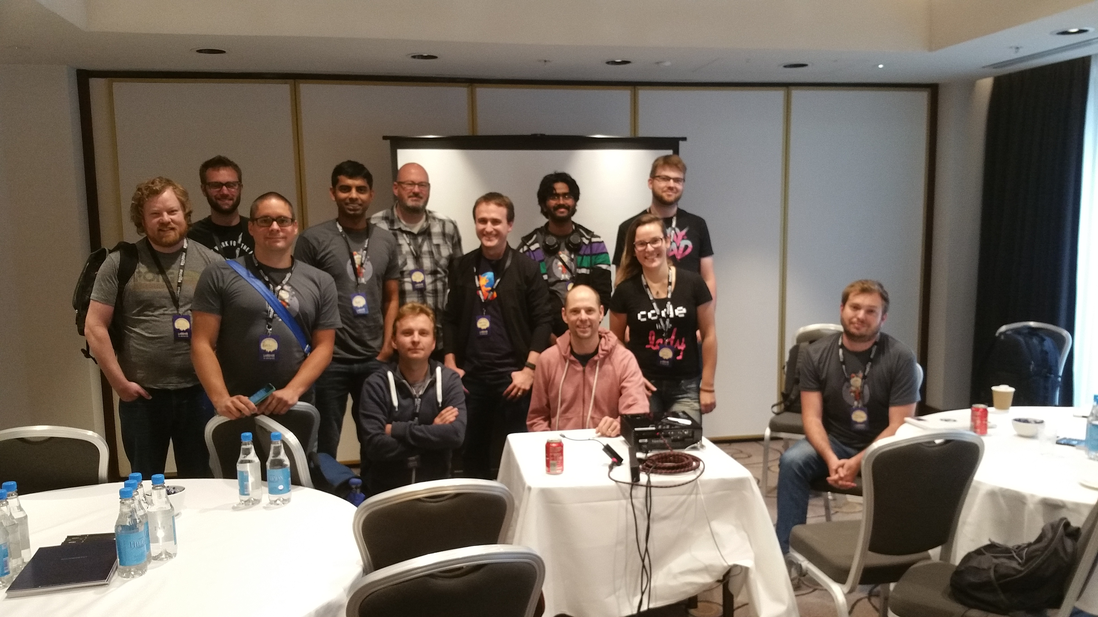
The FxA Team

Slide 22
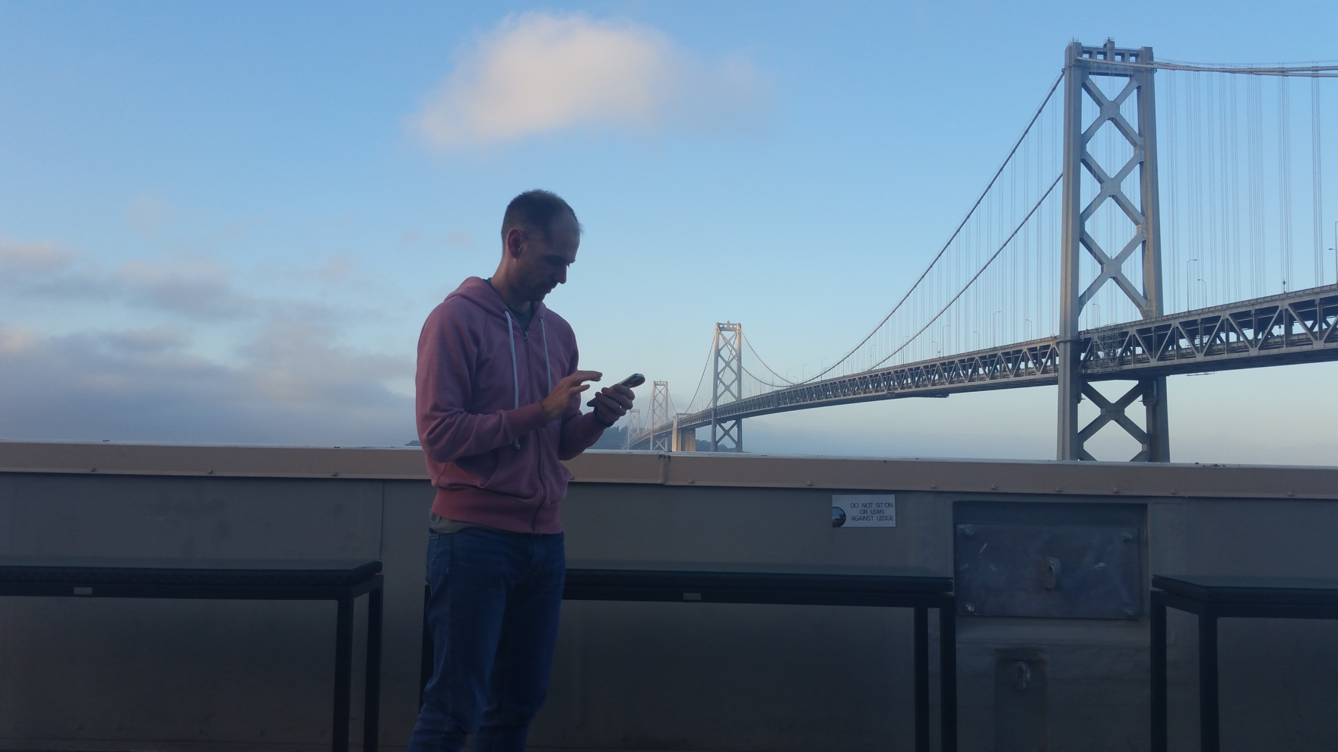
Special Thanks to..
Shane Tomlinson (stomlinson) – My Mentor and Guide
For being patient with me, and helping me separate the “must-haves” and the “nice-to-haves”, and almost everything else this summer ☺
Thanks Shane!!!

Slide 23
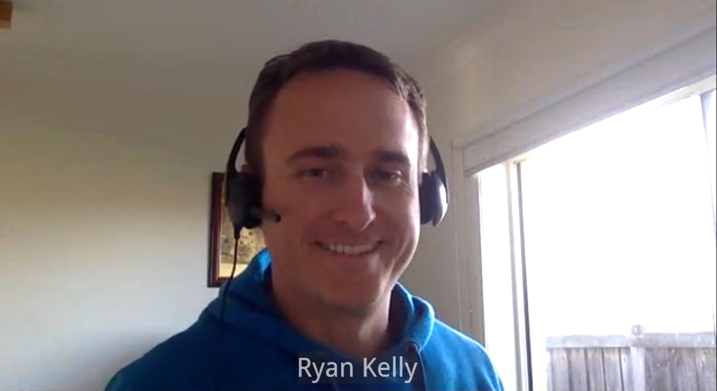
Special Thanks to..
Ryan Kelly (rfk) – My Manager
For guiding me and steering my projects in the right direction by having regular meetings, and organizing meetings for me with other members of the team. Thanks Ryan!!!

Slide 24
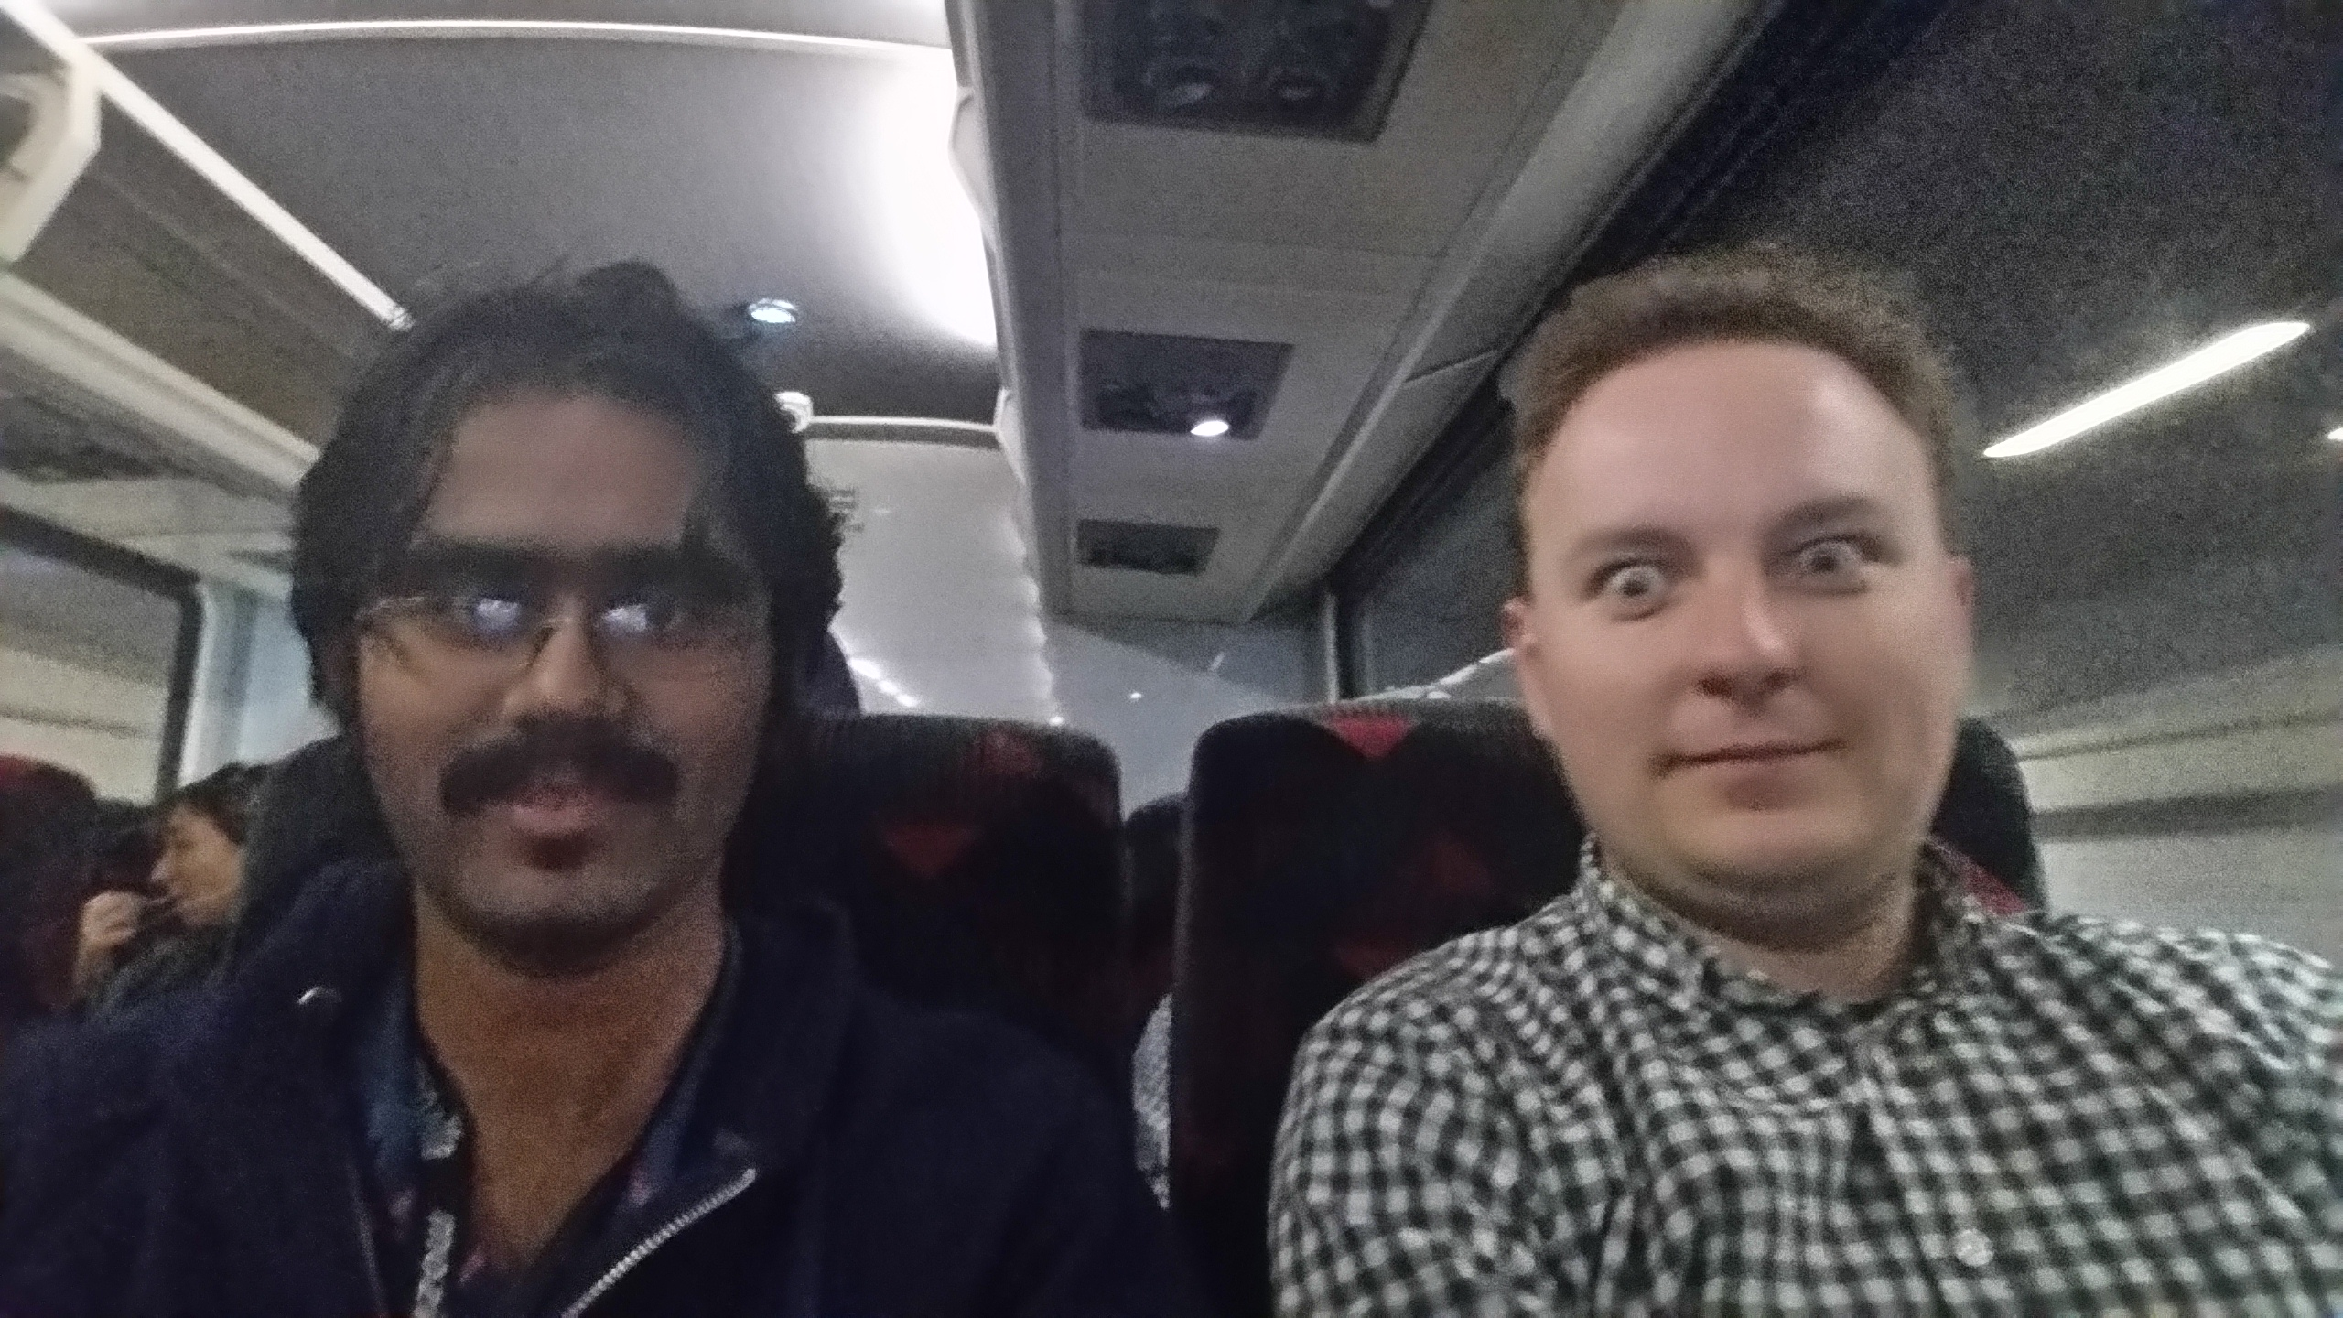
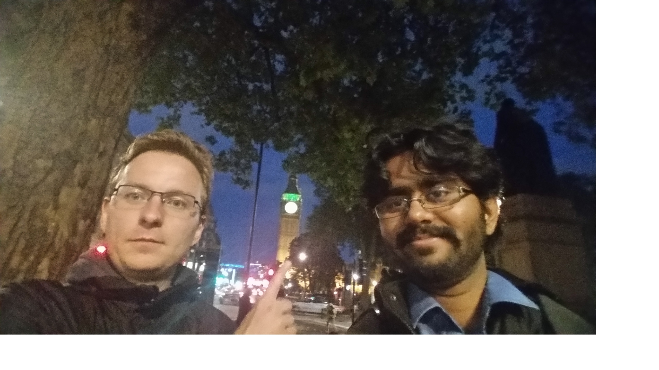
And..
Vlad Filippov (vladikoff) – He is a robot, don’t tell him though.
For the 100+ reviews he gave tirelessly, and for showing me the Big Ben. Thank you so much Vlad! ☺

Slide 25
And..
Vijay Budhram (vbudhram)
For all the help with designing fxa-geodb. Thank you so much Vijay! ☺

Slide 26
And Finallllly….
Peter Dehaan (pdehaan) – a.k.a Sensei.
Thank you so much Peter, for teaching me to always look at the lighter side of software☺

Slide 27
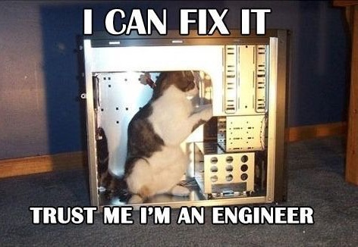
Questions???
The font used on the slides in general is Corbel(Body). The headings are Corbel(Headings). The slides are a default preset from MS Powerpoint.
The font used on this page is Comic Sans MS(aka most hated font of all times), just to irritate anyone who has an aversion to it. Trust me, I am a web developer.

